Slide 1

Data mining and Warehousing
CSC5901
6/25/2021
Data mining and Warehousing CSC5901
1

Slide 2
Unit1: Introduction on
Data mining and Warehousing

Slide 3
Introduction on Data mining

Slide 4
Data
are individual facts, statistics, or items of information, often numeric. In a more technical sense, data are a set of values of qualitative or quantitative variables about one or more persons or objects

Slide 5
What is Data Mining?
Data mining is techniques that help entrepreneurs, researchers, and government and individuals to extract valuable information from huge sets of data explaining the past and predicting the future via Data analysis.

Slide 6
What is Data Mining?
Data mining is also called Knowledge Discovery in Database (KDD).The knowledge discovery process includes
Data cleaning,
Data integration,
Data selection,
Data transformation,
Data mining,
Pattern evaluation, and
Knowledge presentation.

Slide 7
KDD
Many people treat data mining as a synonym for another popularly used term, Knowledge Discovery from Data, or KDD, while others view data mining as merely an essential step in the process of knowledge discovery.
The terms knowledge discovery in databases (KDD) and data mining are often used interchangeably

Slide 8
KDD Process in Data Mining
Why we need Data Mining? Volume of information is increasing everyday that we can handle from business transactions, scientific data, sensor data, Pictures, videos, etc.
So, we need a system that will be capable of extracting essence of information available and that can automatically generate report, views or summary of data for better decision-making.

Slide 9
Why Data Mining is used in Business?
Data mining is used in business to make better managerial decisions by:
Automatic summarization of data
Extracting essence of information stored.
Discovering patterns in raw data.

Slide 10
Steps Involved in KDD Process

Slide 11
Data Cleaning: Data cleaning is defined as removal of noisy and irrelevant data from collection.
Cleaning in case of Missing values.
Cleaning noisy data, where noise is a random or variance error.
Cleaning with Data discrepancy detection and Data transformation tools.
Data Integration: Data integration is defined as heterogeneous data from multiple sources combined in a common source(DataWarehouse).
Data integration using Data Migration tools.
Data integration using Data Synchronization tools.
Data integration using ETL(Extract-Load-Transformation) process.
Notes:
Noisy data are data with a large amount of additional meaningless information in it called noise. This includes data corruption and the term is often used as a synonym for corrupt data. ... Noisy data can adversely affect the results of any data analysis and skew conclusions if not handled properly.

Slide 12
Data Selection:
Data selection is defined as the process where data relevant to the analysis is decided and retrieved from the data collection.
Data selection using Neural network.
Data selection using Decision Trees.
Data selection using Naive bayes.
Data selection using Clustering, Regression, etc.

Slide 13
Data Transformation
Data Transformation is defined as the process of transforming data into appropriate form required by mining procedure. Data Transformation is a two step process:
Data Mapping: Assigning elements from source base to destination to capture transformations.
Code generation: Creation of the actual transformation program.

Slide 14
Data Mining
Data mining is defined as clever techniques that are applied to extract patterns potentially useful.
Transforms task relevant data into patterns.
Decides purpose of model using classification or characterization.

Slide 15
Pattern Evaluation:
Pattern Evaluation is defined as identifying strictly increasing patterns representing knowledge based on given measures.
Find interestingness score of each pattern.
Uses summarization and Visualization to make data understandable by user.

Slide 16
Knowledge representation
Knowledge representation is defined as technique which utilizes visualization tools to represent data mining results.
Generate reports.
Generate tables.
Generate discriminant rules, classification rules, characterization rules, etc.

Slide 17
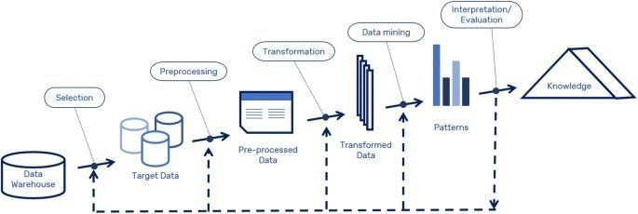
Steps In The Data Mining Process

Slide 18
How this technique work?
uses machine learning, statistics, and AI to extract information to evaluate future events probability

Slide 19
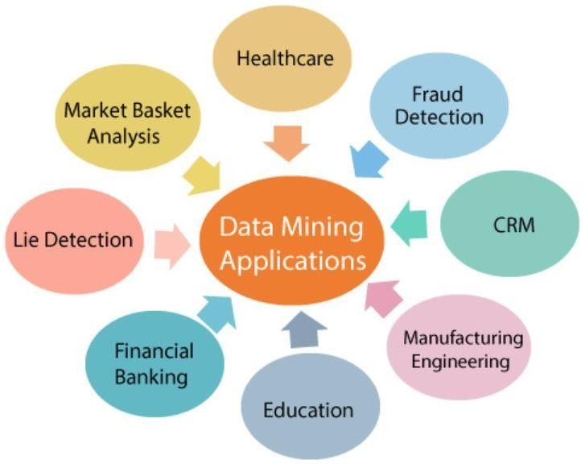
Data Mining Applications

Slide 20
Data mining is highly useful in:
Domains:
Market Analysis and Management
Corporate Analysis & Risk Management
Fraud Detection

Slide 21
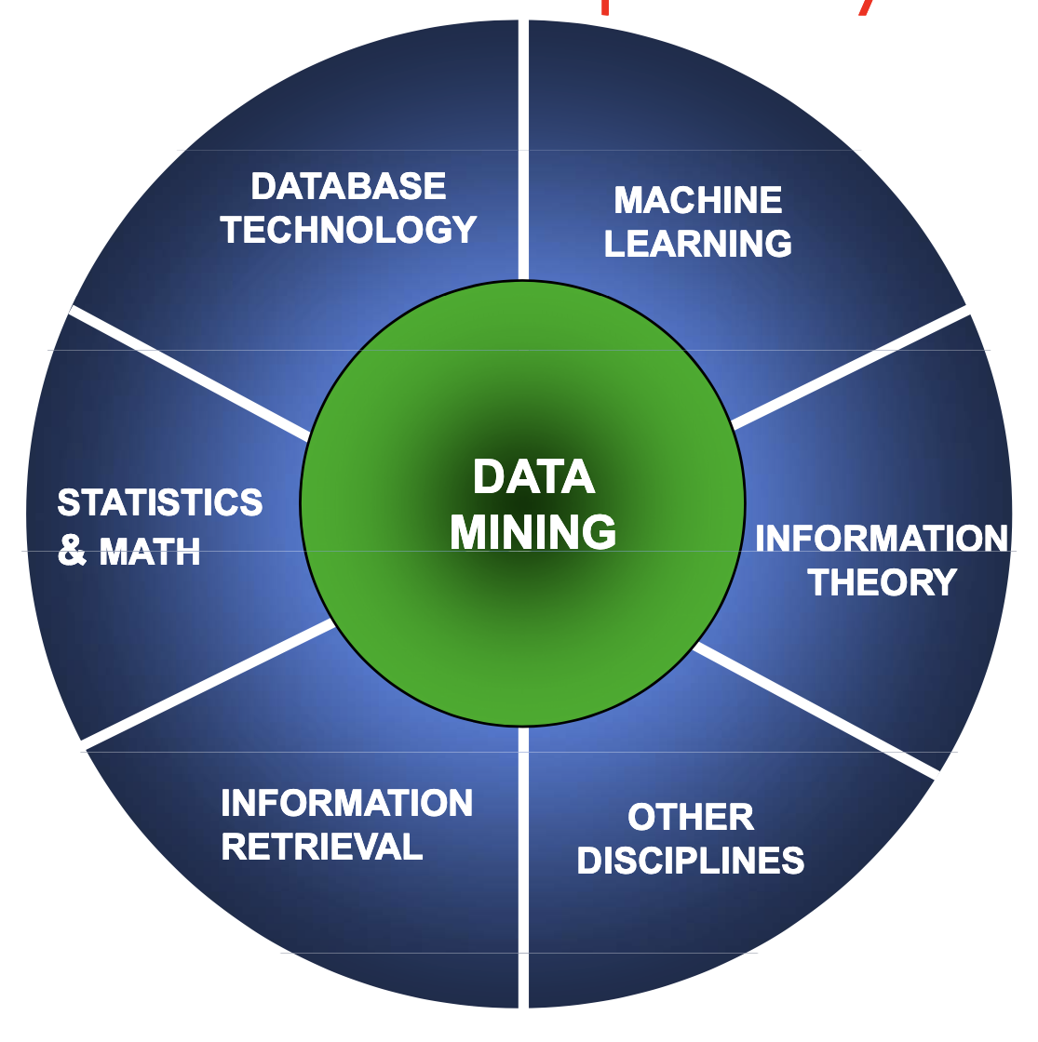
Data Mining is an Interdisciplinary and Multidisciplinary Field

Slide 22
Data mining is highly useful in:(cont..)
Market Analysis and Management (Domain)
Customer Profiling − helps determine what kind of people buy what kind of products.
Identifying Customer Requirements − helps in identifying the best products for different customers. It uses prediction to find the factors that may attract new customers.
Cross Market Analysis − Data mining performs Association/correlations between product sales.

Slide 23
Data mining is highly useful in:(cont..)
Market Analysis and Management( Cont..)
Target Marketing − helps to find clusters of model customers who share the same characteristics such as interests, spending habits, income, etc.
Determining Customer purchasing pattern − helps in determining customer purchasing pattern.
Providing Summary Information − Data mining provides us various multidimensional summary reports.

Slide 24
Data mining is highly useful in:(cont..)
Corporate Analysis and Risk Management
Finance Planning and Asset Evaluation − It involves cash flow analysis and prediction, contingent claim analysis to evaluate assets.
Resource Planning − It involves summarizing and comparing the resources and spending.
Competition − It involves monitoring competitors and market directions.

Slide 25
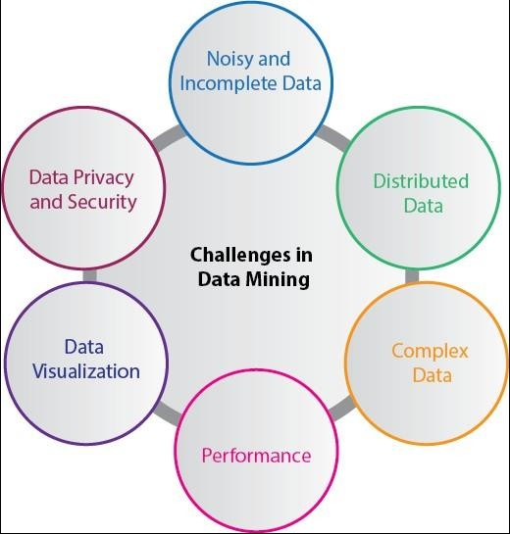
Challenges of Implementation in Data mining

Slide 26
Challenges of Implementation in Data mining
Incomplete and noisy data: The data in the real-world is heterogeneous, incomplete, and noisy. Data in huge quantities will usually be inaccurate or unreliable.
Data Distribution: Real-worlds data is usually stored on various platforms eg email, individual systems, It is not easy to arrange and store as useful information
Complex Data: Real-world data is heterogeneous(different format), and it is not easy to extract useful information.

Slide 27
Challenges of Implementation in Data mining
Performance: The data mining system's performance relies on the efficiency of algorithms and techniques used. If the designed algorithm and techniques used present weakness it will affect performance .
Data Privacy and Security: Data mining usually leads to serious issues in terms of data security, governance, and privacy.
Data Visualization: efficient, and
successful data
visualization processes is very dificult

Slide 28
Introduction on Warehousing

Slide 29
What is Data Warehousing?
It is a technique for collecting and managing data from varied sources to provide meaningful business insights to make a difference.
It is electronic storage of a large
amount of
information by a business which is designed for query
and analysis instead of transaction organization.
processing. in an

Slide 30
What is Data Warehousing?
A Data Warehouse provides integrated, enterprise-
wide, historical data and focuses on providing support for decision makers for data modeling and analysis.
A Data Warehouse is a group of data specific to the
entire organization, not only to a particular group of users.
It is not used for daily operations and transaction processing but used for making decisions.

Slide 31
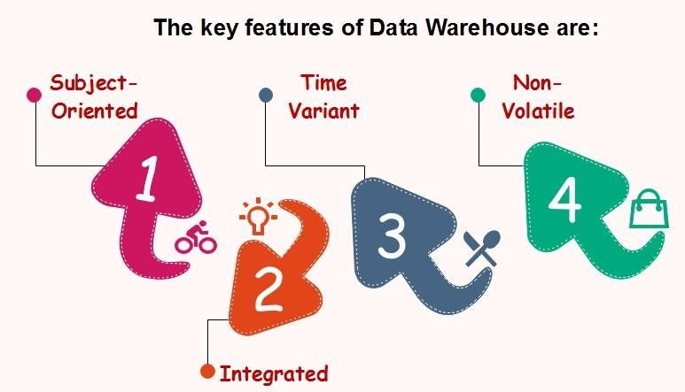
Characteristics/ Features of Data Warehouse

Slide 32
Characteristics/ Features of Data Warehouse
Subject Oriented − it provides information around a subject rather than the organization's ongoing operations. These subjects can be product, customers, suppliers, sales, revenue, etc.
Integrated − A data warehouse is constructed by integrating data from heterogeneous sources such as relational databases, flat files, etc.

Slide 33
Characteristics/ Features of Data Warehouse
Time Variant − The data collected in a data warehouse is identified with a particular time period. The data in a data warehouse provides information from the historical point of view.
Non-volatile − Non-volatile means the previous
data is not erased when new data is added to it.

Slide 34
Major functions of a data warehouse are:
Maintaining past and present records for future decision and prediction.
Helping organizations to take effective business decisions with precise data analysis.

Slide 35
Why data warehouse?
Since a data warehouse can gather information
quickly and efficiently, it can enhance business productivity.
A data warehouse provides overview on subject
, hence, it helps us in subject management.—
A Data Warehouse Saves Time: Since business users can quickly access critical data from a number of sources—all in one place

Slide 36
Why data warehouse?
A Data Warehouse Enhances Data Quality and Consistency: A data warehouse implementation includes the conversion of data from numerous source systems into a common format.
A Data Warehouse Provides Historical Intelligence: A data warehouse stores large amounts of historical data of different time periods, to be analyzed and make future predictions.

Slide 37
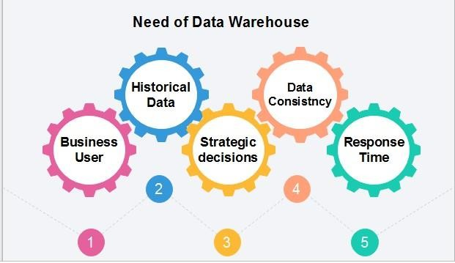
Need for Data Warehouse

Slide 38
Need for Data Warehouse
Business User: need to view summarized data from the past.
Store historical data: is required to store the time variable data from the past.
Make strategic decisions: Some strategies depending upon the data in the data warehouse. So, data warehouse contributes to making strategic decisions.

Slide 39
Need for Data Warehouse
For data consistency and quality: Bringing the data from different sources at a commonplace, sound as good solution.
High response time: demands of a significant degree of flexibility and quick response time is solution for future production and strategic decisions .

Slide 40
Data Warehouse Applications
Banking services
Consumer goods
Financial Services
Retail sectors
Controlled manufacturing

Slide 41
Types of data warehouse
Data mart
Operation data store Enterprise data warehouse

Slide 42
1. Enterprise Data Warehouse (EDW):
Enterprise Data Warehouse (EDW) is a centralized warehouse. It provides decision support service across the enterprise. It offers a unified approach for organizing and representing data. It also provide the ability to classify data according to the subject and give access according to those divisions.

Slide 43
2. Operational Data Store:
Operational Data Store, which is also called ODS, are nothing but data store required when neither Data warehouse nor OLTP systems support organizations reporting needs. In ODS, Data warehouse is refreshed in real time. Hence, it is widely preferred for routine activities like storing records of the Employees.

Slide 44
3. Data Mart:
A data mart is a subset of the data warehouse. It specially designed for a particular line of business, such as sales, finance, sales or finance. In an independent data mart, data can collect directly from sources.

Slide 45
Thank you

